Slide 1


Data Science Capstone Project
Stephen Hrithick
March 15th , 2025

Slide 2
Outline
Executive Summary (3)
Introduction (4)
Methodology (6)
Results (16)
Conclusion (46)
Appendix (47)

Slide 3
Executive Summary
The aim of this research is to analyze Falcon 9 data from SpaceX gathered through various sources and apply machine learning models to predict the success of the first-stage landing. This will enable other space agencies to assess whether they should compete with SpaceX in bidding opportunities.
The following methods were used to collect, analyze, and model the data, as well as to make predictions:
Data Collection: Gathered data via API and web scraping.
Data Transformation: Applied data wrangling techniques to clean and structure the data.
Exploratory Data Analysis: Used SQL and data visualizations to explore the dataset.
Interactive Map: Created a map with Folium to examine the proximity of launch sites.
Dashboard Development: Built an interactive dashboard with Plotly Dash to analyze launch records.
Predictive Modeling: Developed a machine learning model to predict the success of Falcon 9’s first-stage landing.
Summary of all results:
Exploratory Data Analysis results.
Interactive analytics demo in screenshots.
Predictive analysis results
3

Slide 4
Introduction
Project background and context
SpaceX has emerged as the leading company in the commercial space industry, revolutionizing space travel by making it more affordable. The company advertises Falcon 9 launches at a cost of $62 million, while competitors charge upwards of $165 million per launch. A significant portion of the savings comes from SpaceX's ability to reuse the first stage of the rocket. By predicting whether the first stage will successfully land, we can estimate the overall cost of a launch. Using public data and machine learning models, we aim to predict whether SpaceX will be able to reuse the first stage.
Problem
How do variables such as payload mass, launch site, number of flights, and orbits affect the success of the first stage landing?
Does the rate of successful landings increase over the years?
What is the best algorithm that can be used for binary classification in this case?

Slide 5
Methodology
Data collection methodology:
Combined data from SpaceX public API and SpaceX Wikipedia page
Perform data wrangling
Classifying true landings as successful and unsuccessful otherwise
Perform exploratory data analysis (EDA) using visualization and SQL
Perform interactive visual analytics using Folium and Plotly Dash
Perform predictive analysis using classification models
Tuned models using GridSearchCV

Slide 6
Data Collection
Data collection involves gathering information from various available sources, which can be structured, unstructured, or semi-structured. For this project, data was obtained through the SpaceX API and web scraping of relevant launch data from Wikipedia pages.
Data Columns are obtained by using SpaceX REST API: FlightNumber, Date, BoosterVersion, PayloadMass, Orbit, LaunchSite, Outcome, Flights, GridFins, Reused, Legs, LandingPad, Block, ReusedCount, Serial, Longitude, Latitude.
Data Columns are obtained by using Wikipedia Web Scraping: Flight No., Launch site, Payload, PayloadMass, Orbit, Customer, Launch outcome, Version Booster, Booster landing, Date, Time

Slide 7
Data Collection
Data Collection – SpaceX API
Data Collection –
Web Scraping
Request (Space X APIs)
Request Wikipedia html
.JSON file + Lists(Launch Site, Booster Version, Payload Data)
BeautifulSoup html5lib Parser
Json_normalize to DataFrame data from JSON
Find launch info html table
Filter data to only include Falcon 9 launches
Create dictionary
Cast dictionary to a DataFrame
Iterate through table cells to extract data to dictionary
Dictionary relevant data
Cast dictionary to DataFrame
Imputate missing PayloadMass values with mean

Slide 8
Data Wrangling
The dataset includes various instances where the booster did not land successfully. In some cases, a landing attempt failed due to an accident. For example, "True Ocean" indicates a successful landing in a designated ocean region, while "False Ocean" signifies an unsuccessful landing in the same region. Similarly, "True RTLS" represents a successful landing on a ground pad, while "False RTLS" indicates a failed ground pad landing.
"True ASDS" refers to a successful landing on a drone ship, and "False ASDS" denotes an unsuccessful landing on a drone ship. These outcomes are primarily converted into training labels, where "1" signifies a successful landing and "0" indicates an unsuccessful one.
Perform exploratory Data Analysis and determine Training Labels
Calculate the number of launches on each site
Calculate the number and occurrence of each orbit
Calculate the number and occurrence of mission outcome per orbit type
Create a landing outcome label from Outcome column
Exporting the data to CSV
https://github.com/Stephen-507/Python-/blob/6037a1e2f5073354bb9a0725e840d30640801f8a/Data%20Wrangling.ipynb

Slide 9
EDA with Data Visualization
Exploratory Data Analysis (EDA) was conducted on the variables: Flight Number, Payload Mass, Launch Site, Orbit, Class, and Year. The following visualizations were created:
Flight Number vs. Payload Mass
Flight Number vs. Launch Site
Payload Mass vs. Launch Site
Orbit vs. Success Rate
Flight Number vs. Orbit
Payload vs. Orbit
Yearly Success Trend
https://github.com/Stephen-507/Python-/blob/6037a1e2f5073354bb9a0725e840d30640801f8a/EDA%20with%20Data%20Visualization.ipynb

Slide 10
EDA with SQL
Loaded data set into IBM DB2 Database.
Queried using SQL Python integration.
Queries were made to get a better understanding of the dataset.
Queried information about launch site names, mission outcomes, various pay load sizes of customers and booster versions, and landing outcomes
https://github.com/Stephen-507/Python-/blob/6037a1e2f5073354bb9a0725e840d30640801f8a/EDA%20with%20SQL.ipynb

Slide 11
Build an interactive map with Folium
Folium maps mark Launch Sites, successful and unsuccessful landings, and a proximity example to key locations: Railway, Highway, Coast, and City.
This allows us to understand why launch sites may be located where they are. Also visualizes successful landings relative to location.
https://github.com/Stephen-507/Python-/blob/6037a1e2f5073354bb9a0725e840d30640801f8a/Interactive%20Visual%20Analytics%20with%20Folium.ipynb

Slide 12
Build a Dashboard with Plotly Dash
The dashboard features a pie chart and a scatter plot for data visualization.
The pie chart can display the distribution of successful landings across all launch sites or show the success rate for individual launch sites.
The scatter plot takes two inputs: it allows users to select either all sites or a specific site, and features a slider to adjust payload mass between 0 and 10,000 kg.
The pie chart provides a clear view of the success rate for each launch site, while the scatter plot helps visualize how success rates vary based on launch site, payload mass, and booster version.
https://github.com/Stephen-507/Python-/blob/ee562efd0ab0420690214c7e43e2185bc0058bbb/spacex_dash_app.py

Slide 13
Predictive analysis (Classification)
Split label column
Score models on
Confusion Matrix
‘Class’ from dataset
split test set
for all models
Fit and Transform
Use GridSearchCV
Features using
on LogReg, SVM,
Barplot to compare scores of models
Standard Scaler
Decision Tree, and
KNN models
Train_test_split
GridSearchCV
data
(cv=10) to find optimal parameters
https://github.com/Stephen-507/Python-/blob/ee562efd0ab0420690214c7e43e2185bc0058bbb/Machine%20Learning%20Prediction.ipynb

Slide 14
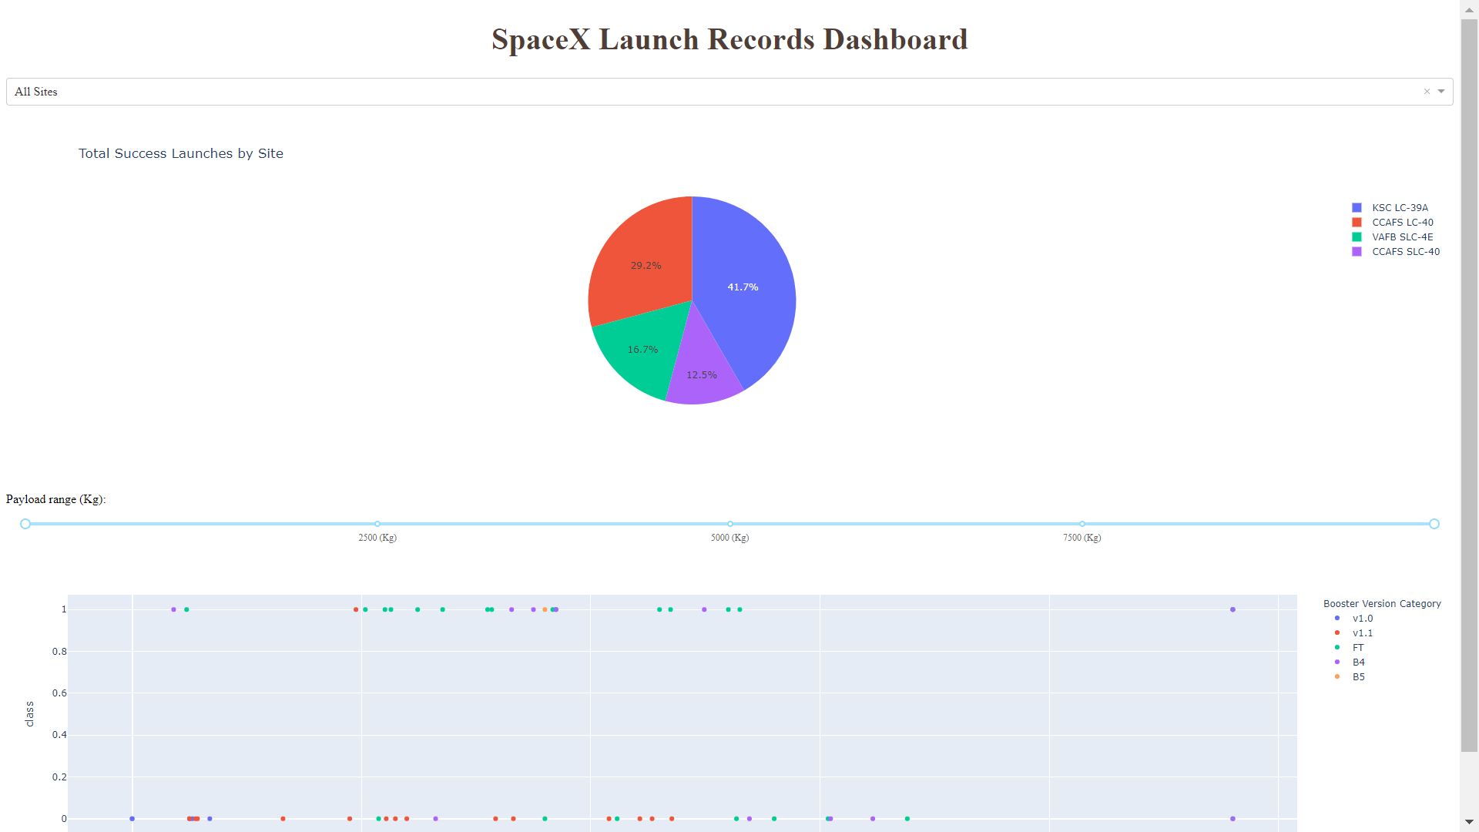
Results
This is a preview of the Plotly dashboard. The following sides will show the results of EDA with visualization, EDA with SQL, Interactive Map with Folium, and finally the results of our model with about 83% accuracy.

Slide 15
EDA WITH VISUALIZATION
EXPLORATORY DATA ANALYSIS WITH SEABORN PLOTS

Slide 16
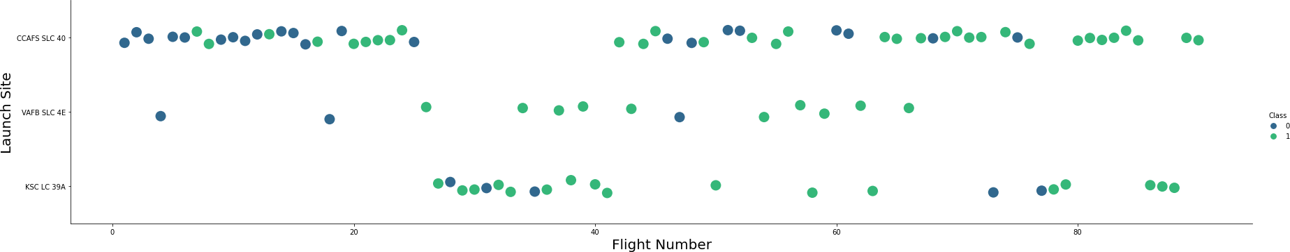
Flight Number vs. Launch Site
Green indicates successful launch; Purple indicates unsuccessful launch.
Graphic suggests an increase in success rate over time (indicated in Flight Number). Likely a big breakthrough around flight 20 which significantly increased success rate. CCAFS appears to be the main launch site as it has the most volume.

Slide 17
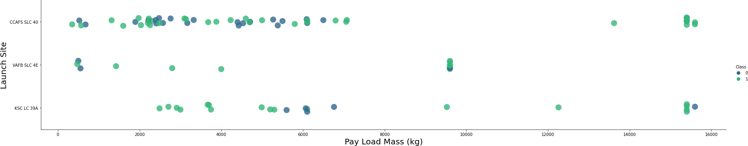
Payload vs. Launch Site
Green indicates successful launch; Purple indicates unsuccessful launch.
Payload mass appears to fall mostly between 0-6000 kg. Different launch sites also seem to use different payload mass.

Slide 18
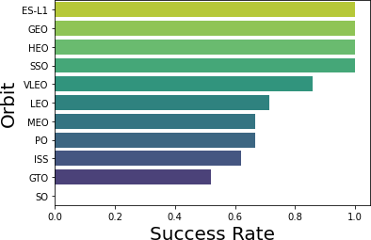

Success rate vs. Orbit type
Success Rate Scale:
0 as 0%
0.6 as 60%
1 as 100%
ES-L1 (1), GEO (1), HEO (1) have 100% success rate (sample sizes in parenthesis) SSO (5) has 100% success rate
VLEO (14) has decent success rate and attempts
SO (1) has 0% success rate
GTO (27) has the around 50% success rate but largest sample

Slide 19
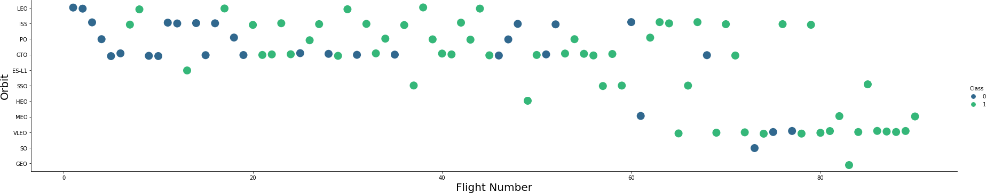
Flight Number vs. Orbit type
Green indicates successful launch; Purple indicates unsuccessful launch.
Launch Orbit preferences changed over Flight Number.
Launch Outcome seems to correlate with this preference.
SpaceX started with LEO orbits which saw moderate success LEO and returned to VLEO in recent launches
SpaceX appears to perform better in lower orbits or Sun-synchronous orbits
19

Slide 20
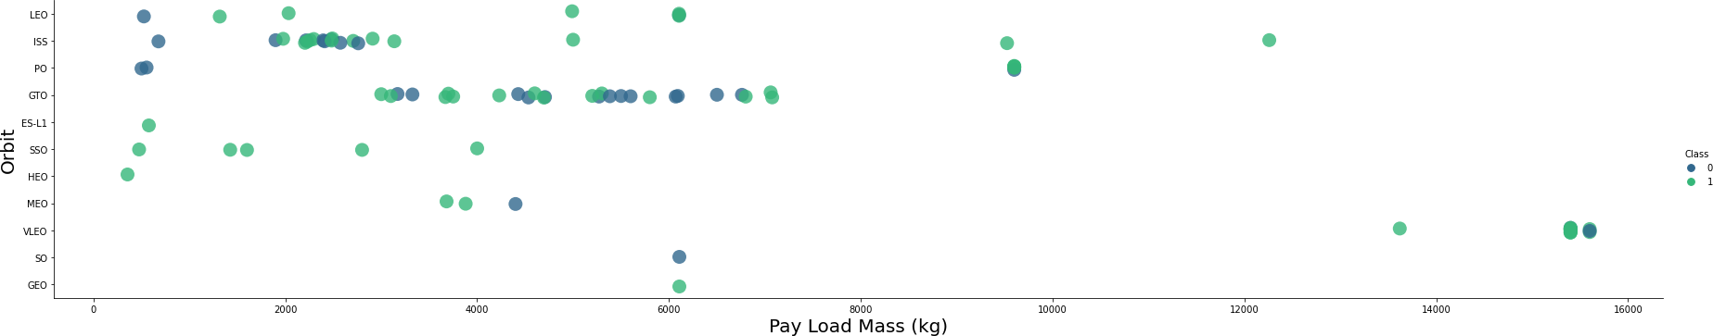
Payload vs. Orbit type
Green indicates successful launch; Purple indicates unsuccessful launch.
Payload mass seems to correlate with orbit
LEO and SSO seem to have relatively low payload mass
The other most successful orbit VLEO only has payload mass values in the higher end of the range

Slide 21
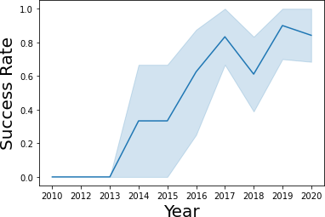
Launch Success Yearly Trend
95% confidence interval (light blue shading)
Success rate increased since 2013 with a slight dip in 2018
Success in recent years stands at around 80%

Slide 22
EDA WITH SQL
EXPLORATORY DATA ANALYSIS WITH SQL DB2
INTEGRATED IN PYTHON WITH SQL ALCHEMY

Slide 23
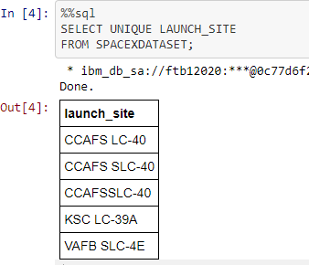
All Launch Site Names
Query unique launch site names from database.
CCAFS SLC-40 and CCAFSSLC-40 likely all represent the same
launch site with data entry errors.
CCAFS LC-40 was the previous name.
Likely only 3 unique launch_site values: CCAFS SLC-40, KSC LC-39A, VAFB SLC-4E

Slide 24
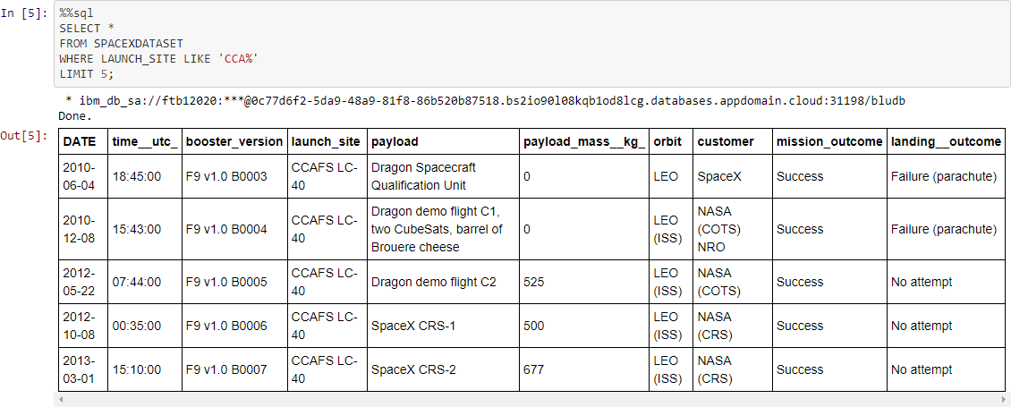
Launch Site Names Beginning with `CCA`
First five entries in database with Launch Site name beginning with CCA.

Slide 25
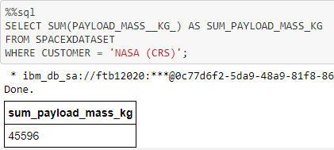
Total Payload Mass from NASA
This query sums the total payload mass in kg where NASA was the customer.
CRS stands for Commercial Resupply Services which indicates that these payloads were sent to the International Space Station (ISS).

Slide 26
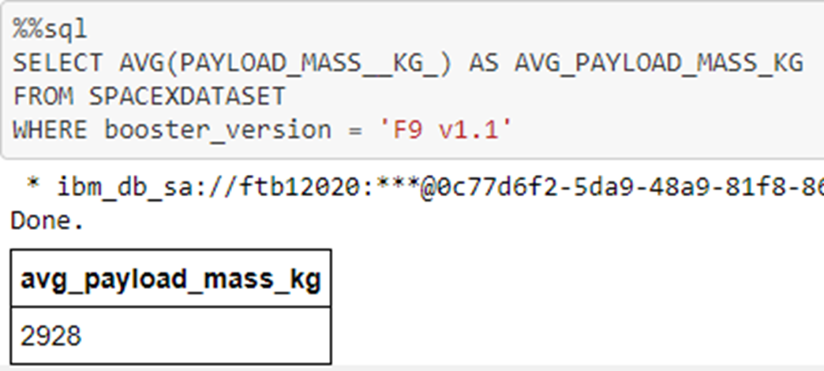
Average Payload Mass by F9 v1.1
This query calculates the average payload mass or launches which used booster version F9 v1.1
Average payload mass of F9 1.1 is on the low end of our payload mass range

Slide 27
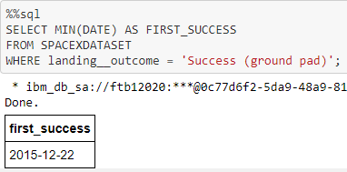
First Successful Ground Pad Landing Date
This query returns the first successful ground pad landing date.
First ground pad landing wasn’t until the end of 2015.
Successful landings in general appear starting 2014.

Slide 28
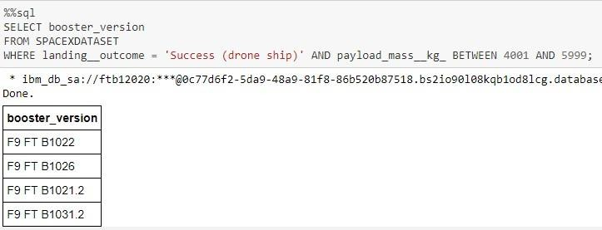
Successful Drone Ship Landing with Payload Between 4000 and 6000
This query returns the four booster versions that had successful drone ship landings and a payload mass between 4000 and 6000 exclusively.

Slide 29
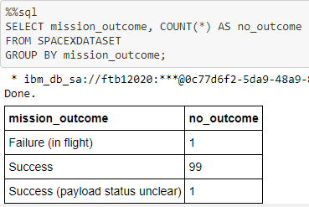
Total Mission Outcome
This query returns a count of each mission outcome.
SpaceX appears to achieve its mission outcome nearly 99% of the time.
Interestingly, one launch has an unclear payload status and unfortunately one failed in flight.

Slide 30
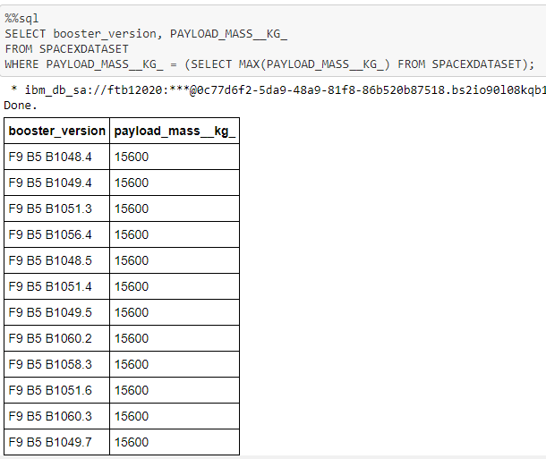
Boosters that Carried Maximum Payload
This query returns the booster versions that carried the highest payload mass of 15600 kg.
These booster versions are very similar and all are of the F9 B5 B10xx.x variety.
This likely indicates payload mass correlates with the booster version that is used.

Slide 31
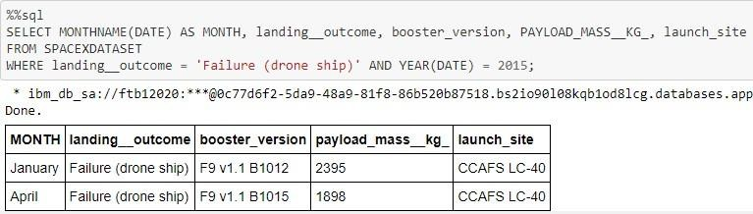
2015 Failed Drone Ship Landing Records
This query returns the Month, Landing Outcome, Booster Version, Payload Mass (kg), and Launch site of 2015 launches where stage 1 failed to land on a drone ship.
There were two such occurrences.

Slide 32
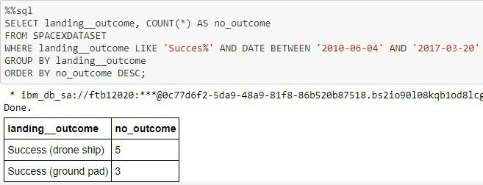
Ranking Counts of Successful Landings Between 2010-06-04 and 2017-03-20
This query returns a list of successful landings and between 2010-06-04 and 2017-03-20 inclusively.
There are two types of successful landing outcomes: drone ship and ground pad landings.
There were 8 successful landings in total during this time period

Slide 33
Interactive Map with Folium

Slide 34
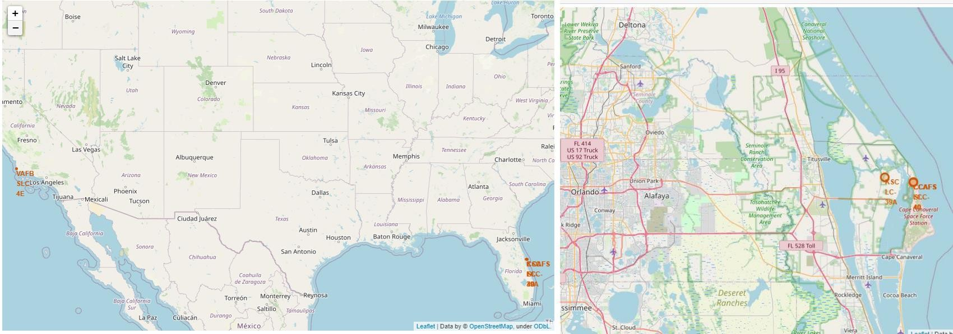
Launch Site Locations
The left map shows all launch sites relative US map. The right map shows the two Florida launch sites since they are very close to each other. All launch sites are near the ocean.

Slide 35
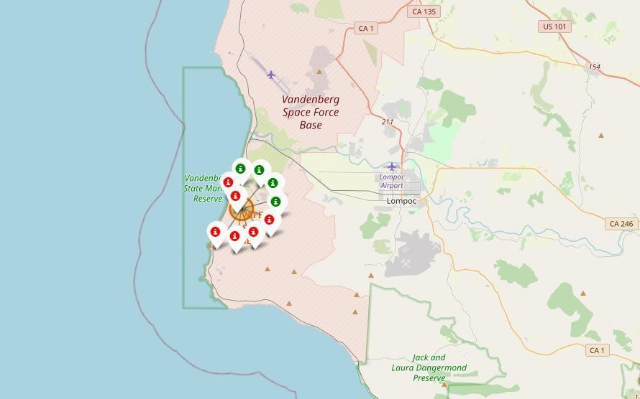
Color-Coded Launch Markers
Clusters on Folium map can be clicked on to display each successful landing (green icon) and failed
landing (red icon). In this example VAFB SLC-4E shows 4 successful landings and 6 failed landings.

Slide 36
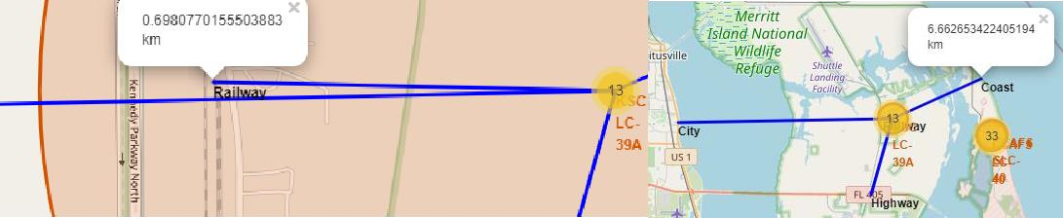
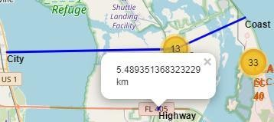
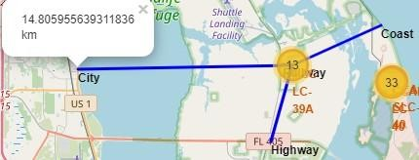
Key Location Proximities
Using KSC LC-39A as an example, launch sites are very close to railways for large parts transportation. Launch sites are close to highways for human and supply transport. Launch sites are also close to coasts and relatively far from cities so that launch failures can land in the sea to avoid rockets falling on densely populated areas.

Slide 37
Build a Dashboard with Plotly Dash

Slide 38
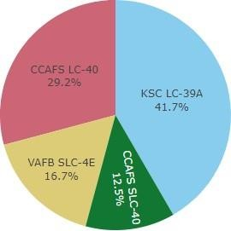

Successful Launches Across Launch Sites
This is the distribution of successful landings across all launch sites.
CCAFS LC-40 is the old name of CCAFS SLC-40 so CCAFS and KSC have the same number of successful landings, but a majority of the successful landings were performed before the name change.
VAFB has the smallest share of successful landings. This may be due to smaller sample and increase in difficulty of launching in the west coast.

Slide 39
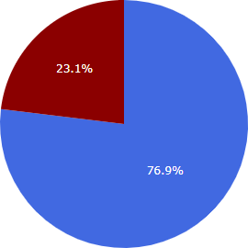

Highest Success Rate Launch Site
KSC LC-39A has the highest success rate with 10 successful landings and 3 failed landings.

Slide 40
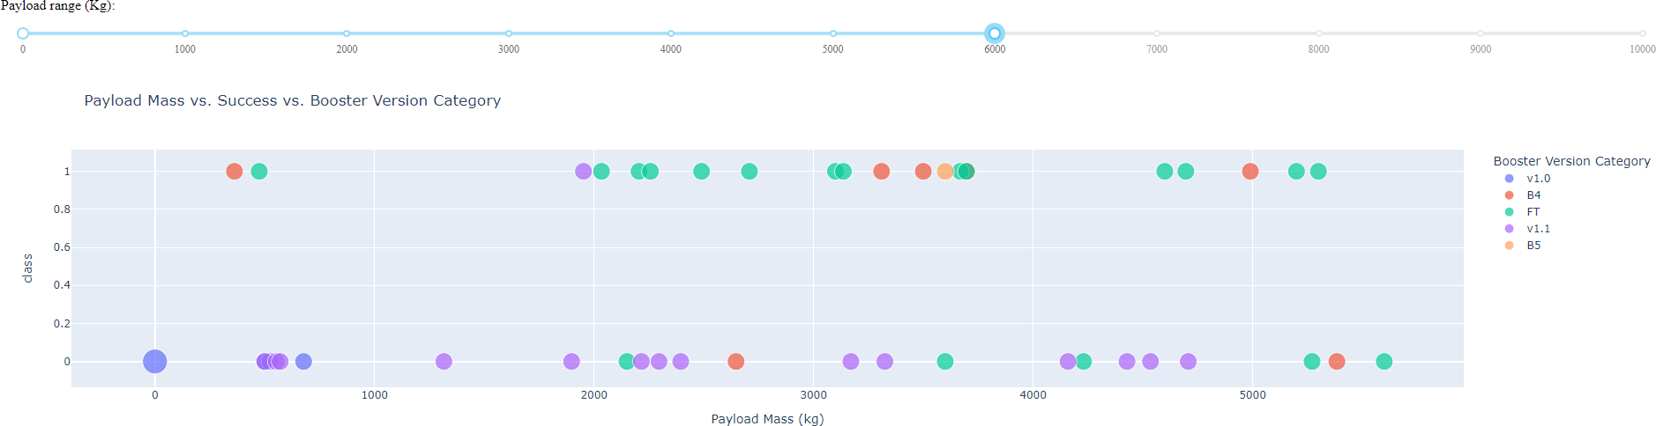
Payload Mass vs. Success vs. Booster Version Category
Plotly dashboard has a Payload range selector. However, this is set from 0-10000 instead of the max Payload of 15600.
Class indicates 1 for successful landing and 0 for failure.
Scatter plot also accounts for booster version category in color and number of launches in point size.
In this particular range of 0-6000, interestingly there are two failed landings with payloads of zero kg.

Slide 41
Predictive Analysis (Classification)
GRIDSEARCHCV(CV=10) ON LOGISTIC REGRESSION, SVM, DECISION TREE, AND KNN

Slide 42
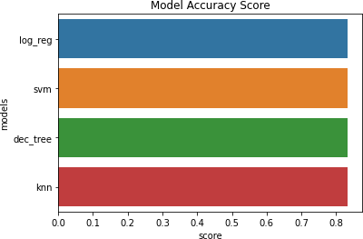
Classification Accuracy
All models had virtually the same accuracy on the test set at 83.33% accuracy. It should be noted that test size is small at only sample size of 18.
This can cause large variance in accuracy results, such as those in Decision Tree Classifier model in repeated runs.
We likely need more data to determine the best model.

Slide 43
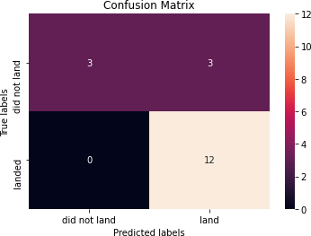
Confusion Matrix
Since all models performed the same for the test set, the confusion matrix is the same across all models. The models predicted 12 successful landings when the true label was successful landing.
The models predicted 3 unsuccessful landings when the true label was unsuccessful landing.
The models predicted 3 successful landings when the true label was unsuccessful landings (false positives). Our models over predict successful landings.
Correct predictions are on a diagonal from top left to bottom right.

Slide 44
CONCLUSION
Our task was to develop a machine learning model for SpaceY, aiming to compete with SpaceX.
The objective of the model is to predict the likelihood of a successful Stage 1 landing, potentially saving around $100 million USD.
We utilized data from a public SpaceX API and scraped information from the SpaceX Wikipedia page.
After processing the data, we created labels and stored the information in a DB2 SQL database.
We then developed a machine learning model, which achieved an accuracy of 83%.
This allows the company to decide whether to proceed with the launch, potentially reducing risks and costs.
To further enhance the model’s performance, additional data collection would be beneficial to fine-tune the model and improve its accuracy.

Slide 45
APPENDIX
GitHub repository URL: https://github.com/Stephen-507/Python-
Special Thanks To:
Instructors
Coursera

Slide 46
Thank you

